Slide 1

Model Blimp Design Competition
Programming Workshop by
Youth College (International) / VTC
---11 May 2019---

Slide 2
Lecturer
Edmond Leung
Senior Lecturer
Youth College (International)
Vocational Training Council (VTC)
Email : whleung@vtc.edu.hk

Slide 3
Wifi and file download
Wifi SSID:
YCI_2_4G / YCI_5G
Or
YCI_2_4G_2 / YCI_5G_2
Password:
ycinternational
PowerPoint and material download
//172.19.124.20
User : airship
Password : ycinternational

Slide 4
Content
Background of Arduino and ESP8266 (D1 mini)
Installation of Arduino IDE and CH340 Driver for ESP8266
Arduino Programming Environment
Blink program on ESP8266
Basic C- Syntax : Variable, For loop, if… then… else…
Serial communication
Motor control on ESP8266 (analogWrite)
Android Wifi-hot and Wifi TCP/UDP Controller
Wifi (UDP package) between Android and ESP8266

Slide 5
1. Background of Arduino
The first Arduino was introduced in 2005.
A project for students at the Interaction Design Institute Ivrea in Ivrea, Italy
provide an inexpensive and easy way for hobbyists, students, and professionals to create devices that interact with their environment using sensors and actuators
Common examples for beginner hobbyists include simple robots, thermostats and motion detectors.

Slide 6
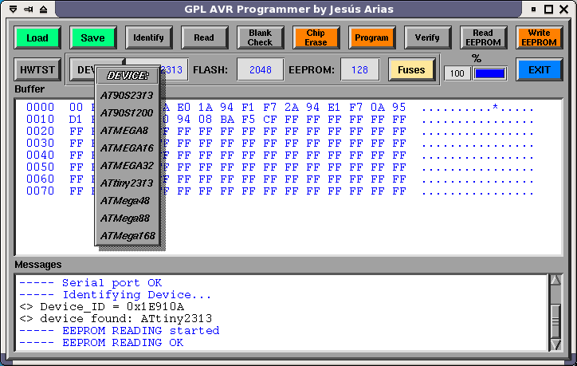
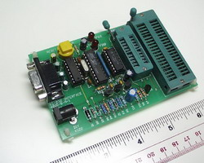
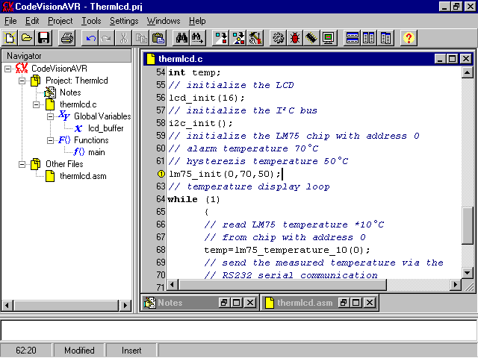
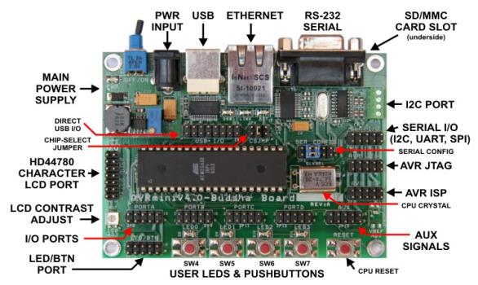
Before Arduino
AVR Programmer
AVR Programmer
software
RS232
Development Platform

Slide 7
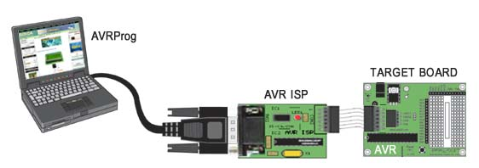
Before Arduino
Improvement -> In System Programming

Slide 8
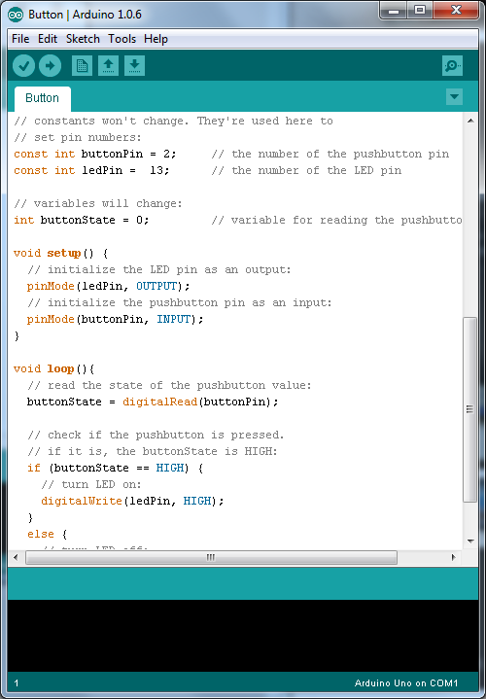
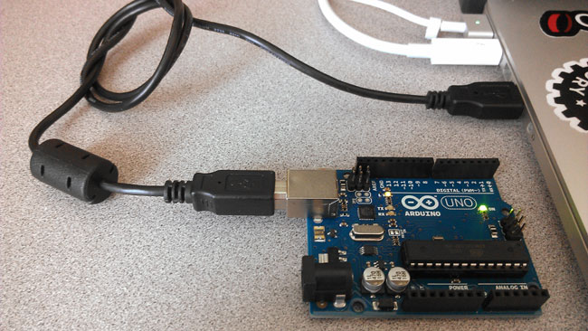
Arduino IDE
Free development platform
USB programmable

Slide 9
Arduino Boot loader
Simplified the programming process
Run User Program when startup
Detect New program from development platform
User Program
Arduino Boot Loader
Microcontroller Flash memory

Slide 10
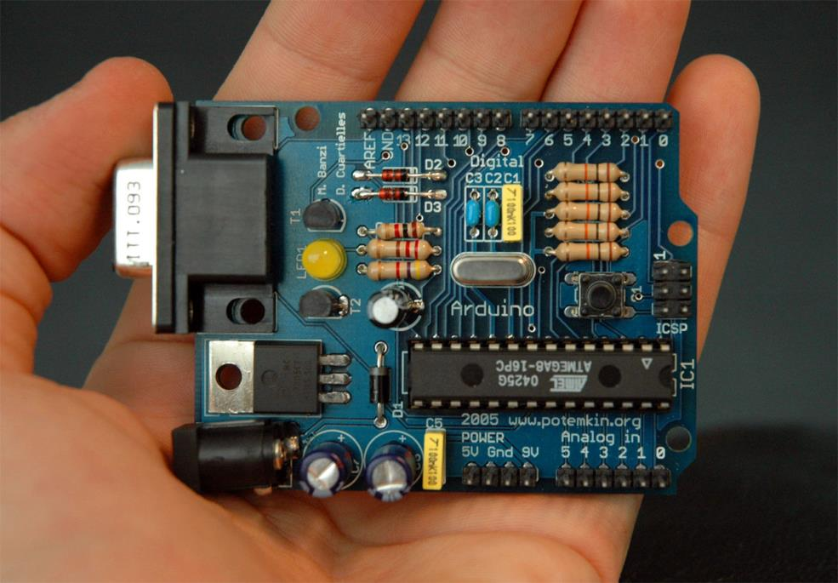
Arduino Board
An early Arduino board with an RS-232 serial interface (upper left)

Slide 11
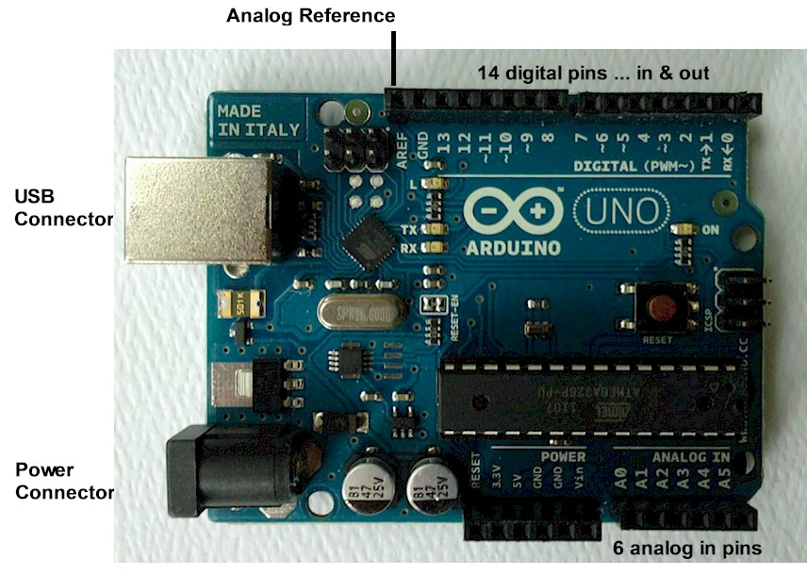
Arduino Board
An official Arduino Uno with descriptions of the I/O locations

Slide 12
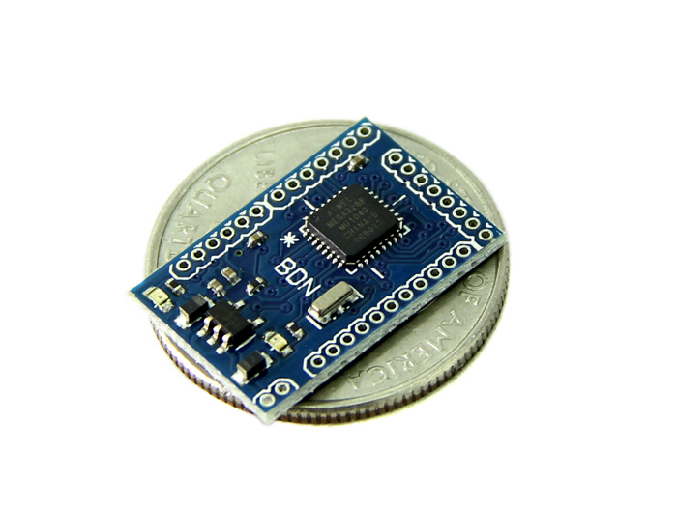
Arduino Board
Smallest Arduino Compatible Board

Slide 13
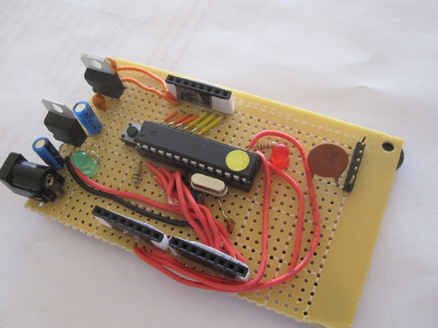
Arduino Board
DIY Arduino Board

Slide 14
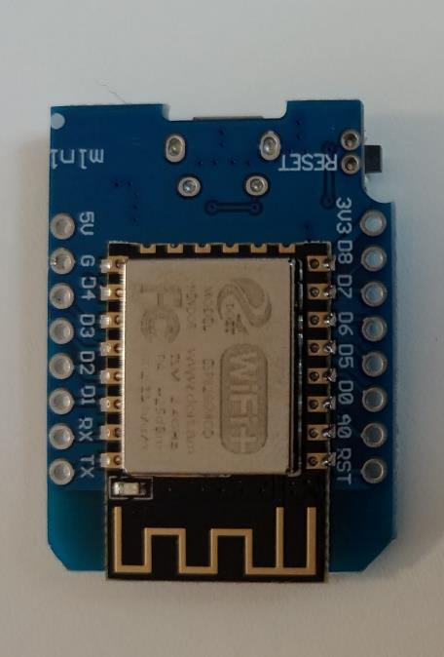
Wifi + Processor => ESP8266
An integrated with Wifi microchip and microcontroller capability produced by manufacturer – Espressif Systems in Shanghai
IEEE 802.11 b/g/n Wifi (2.4G)
32-bit microcontroller
@ 80 MHz (default) or 160 MHz
32 KiB instruction, 80 KiB user data

Slide 15
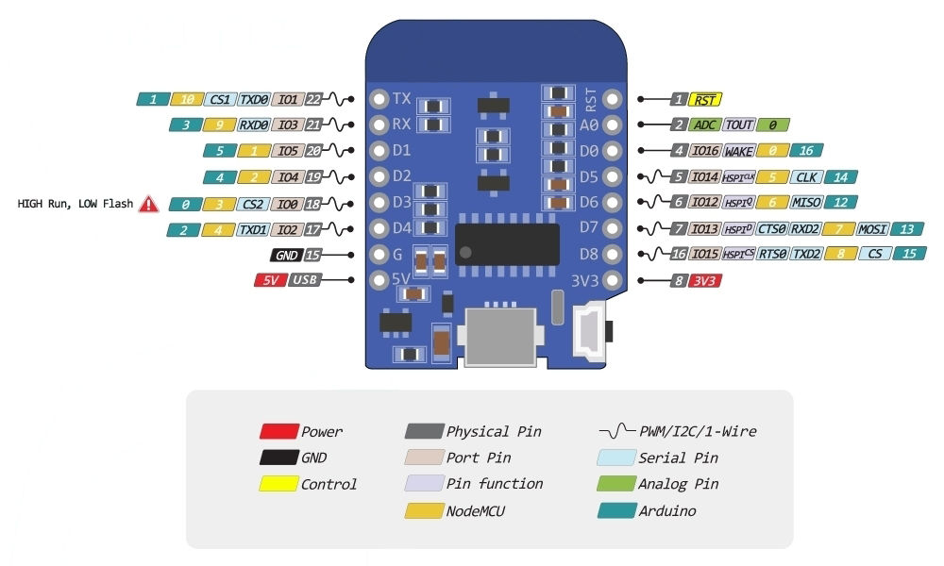
Pinout of D1 mini (ESP8266)
MiniUSB

Slide 16
2. Installation of Arduino IDE and
CH340 Driver for ESP8266

Slide 17
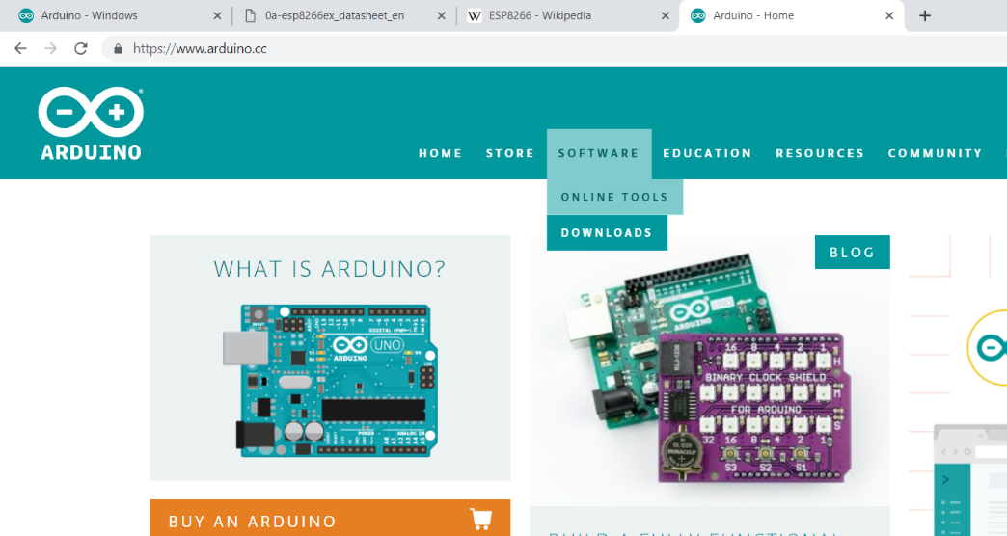
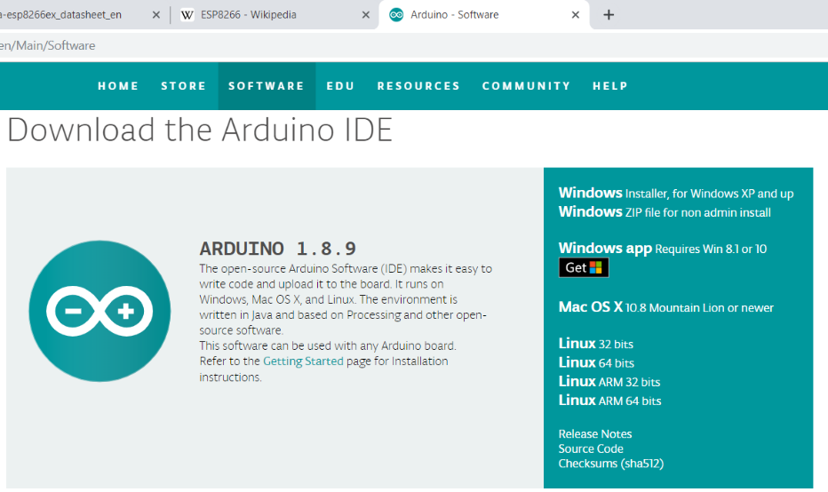
Step 1 : Arduino IDE and CH340 Driver for D1 mini (ESP8266)
Download and install the Arduino
https://www.arduino.cc/

Slide 18

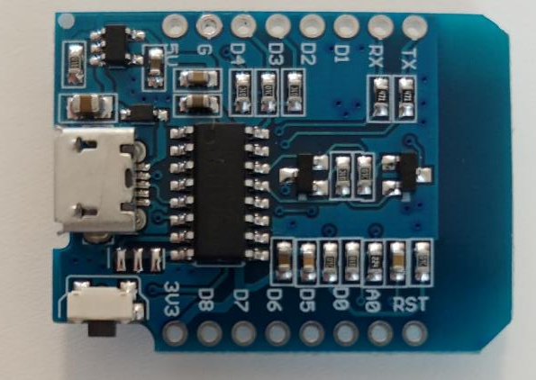
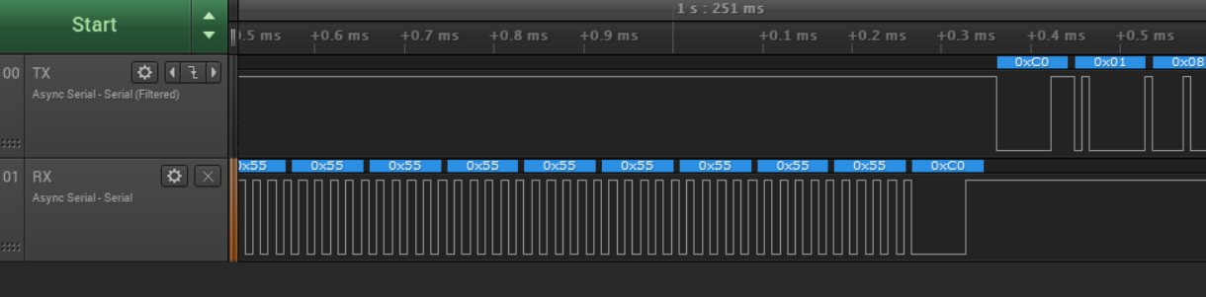
Step 2: USB-COM Driver
D1 Mini
(We are using)
USB
Using an IC (CH340) to convert signal between
RS232 (TTL signal) <-> USB

Slide 19
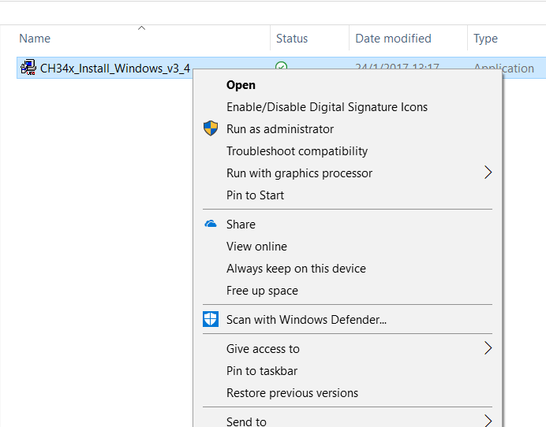
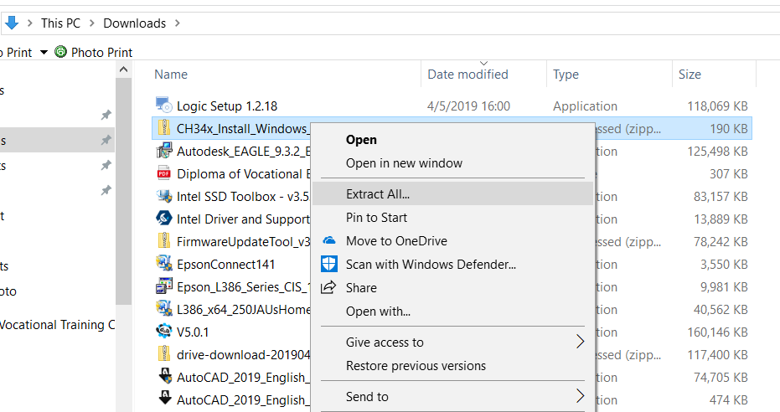
Step 2: Install CH340 Driver
Download the CH340 Driver from the follow website
https://sparks.gogo.co.nz/ch340.html

Slide 20
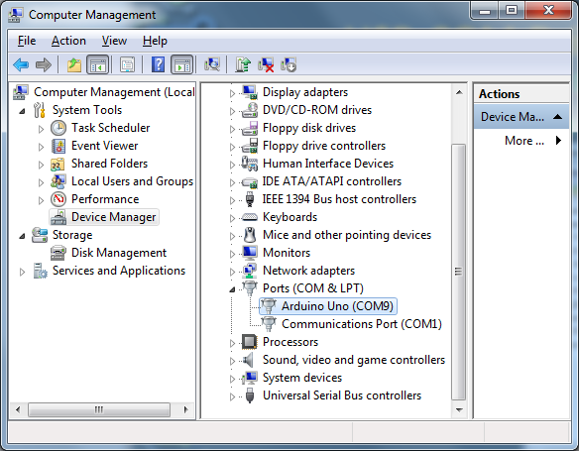
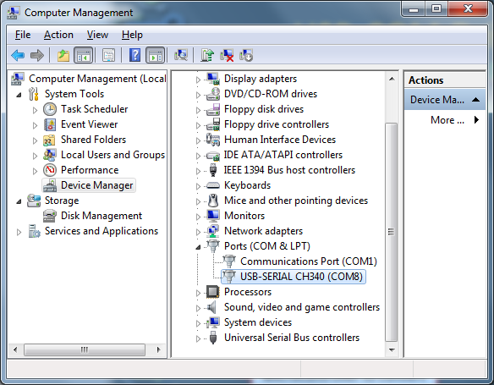
Step 2 : USB-COM Driver
For Official Arduino UNO
(Driver come with IDE)
For D1 mini through CH340 (We are using)

Slide 21
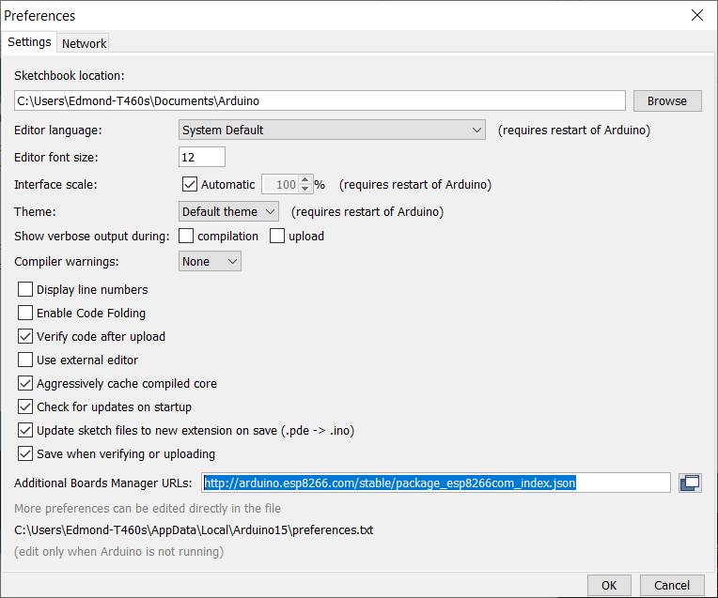
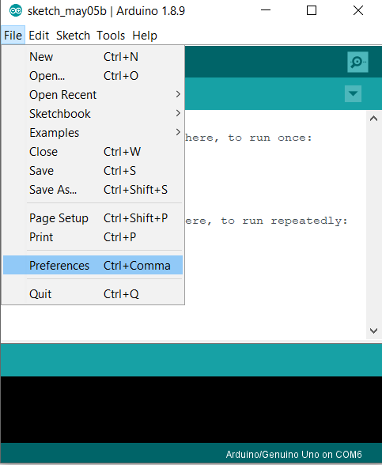
Step 3 : install D1 mini on Arduino IDE
http://arduino.esp8266.com/stable/package_esp8266com_index.json

Slide 22
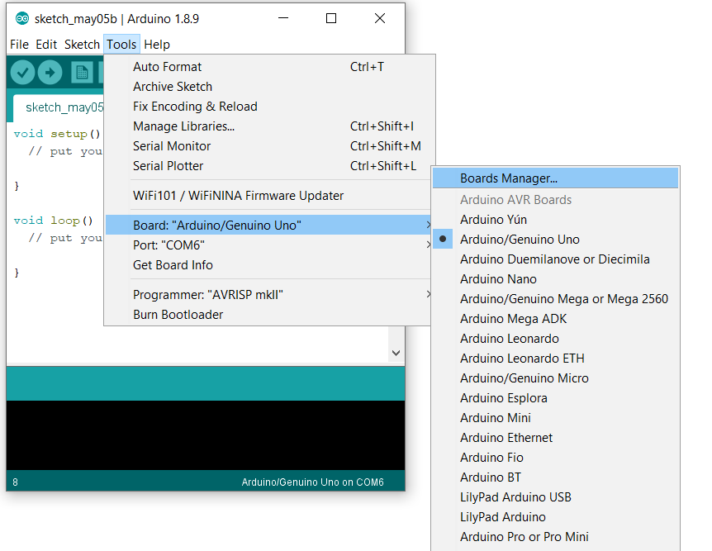
Step 3 : install D1 mini on Arduino IDE

Slide 23
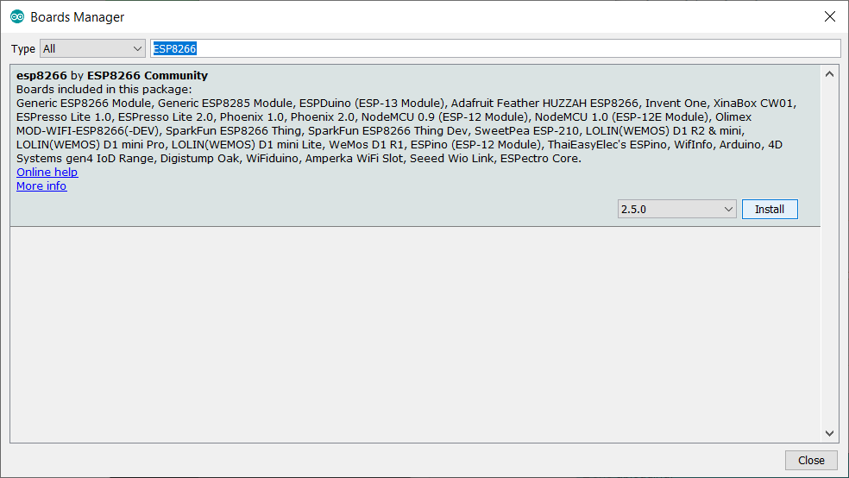
Step 3 : install D1 mini on Arduino IDE
Search for ESP8266

Slide 24
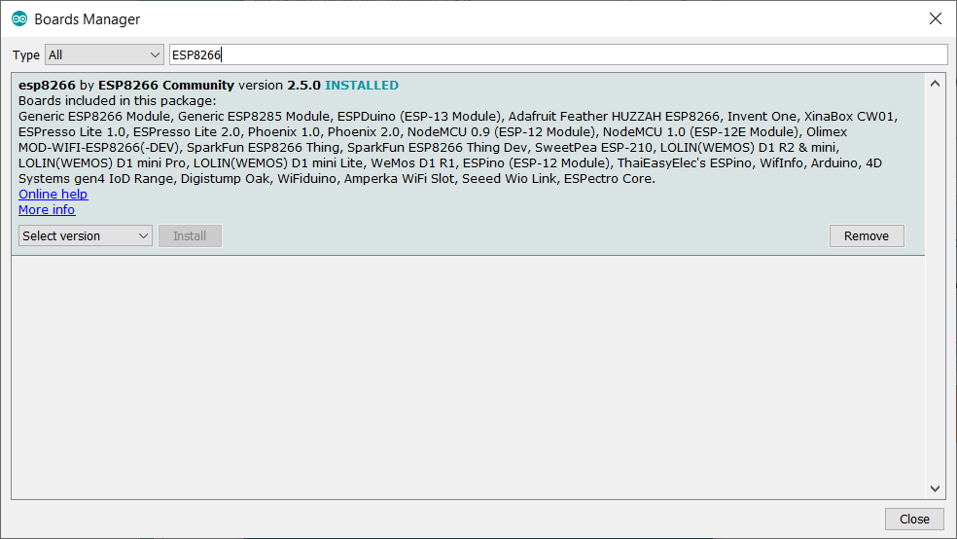
Step 3 : install D1 mini on Arduino IDE
INSTALLED Should be shown

Slide 25
3. Arduino Programming Environment

Slide 26
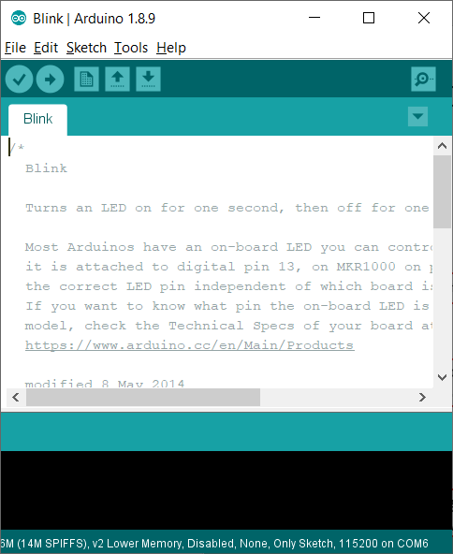
Arduino IDE
Existing file name
IDE Version
Tools list
Program Code editing area
Arduino Board name and com port no.
Message window

Slide 27


Arduino IDE - tools
Verify : Verify the program without error
Upload : upload program code after compile
New : open new file
Open : open existing file
Save : Save file
Serial Monitor : Communicate with Arduino through USB-serial port (Terminal)

Slide 28
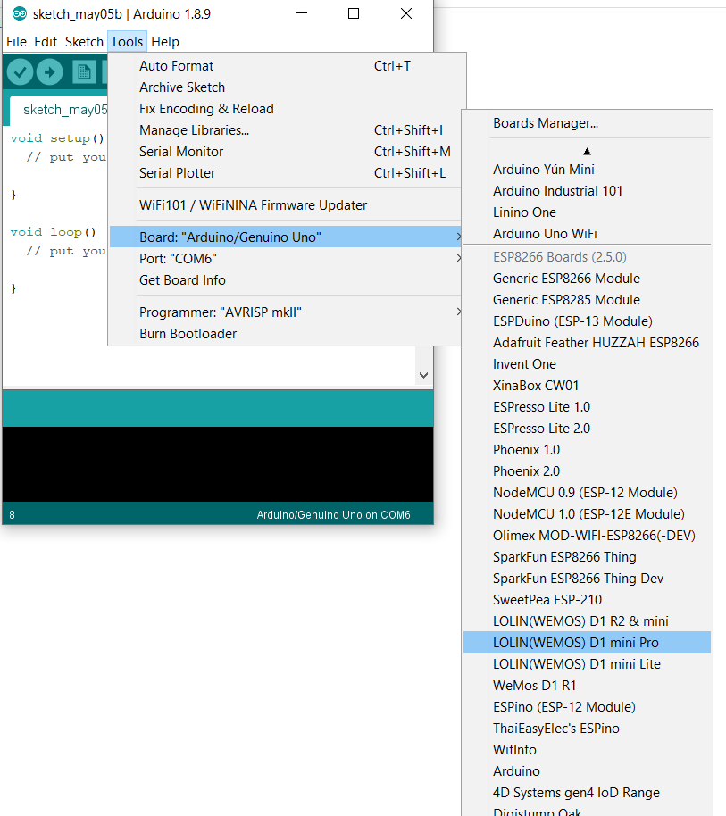
Arduino IDE – select board

Slide 29
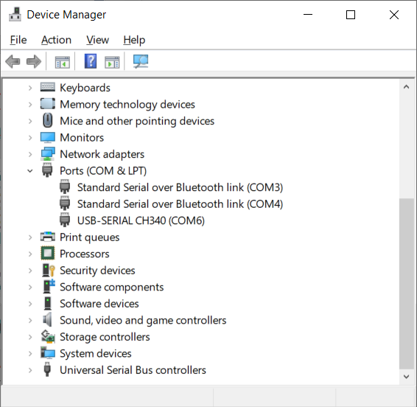
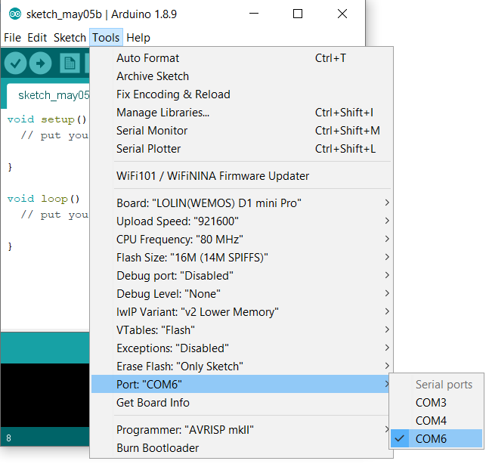
Arduino IDE – select COM port

Slide 30
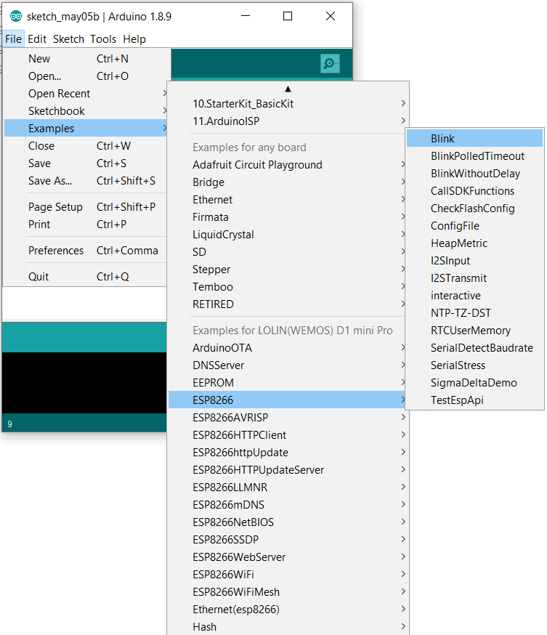
Upload LED Blink Example
Open example from
File
01. Basics
Blink

Slide 31
4. Blink program on ESP8266

Slide 32
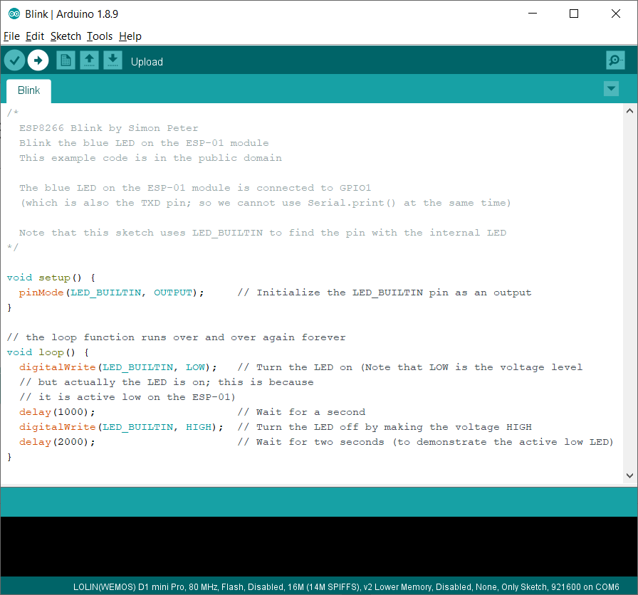
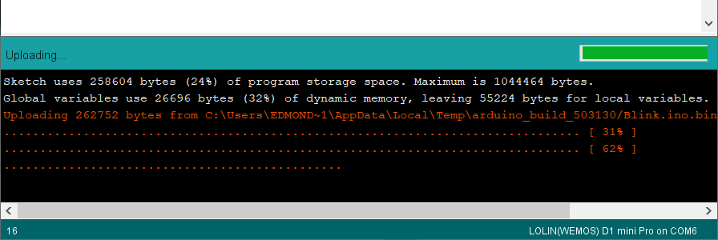
Upload LED (Arduino pin 2) Blink Example

Slide 33
Arduino Programming
Anything between /* and */
Will be ignored (For programmer give comments and remarks)
Anything after // will be ignored also
Setup() : a function run once at the start of a program that can initialize settings. In here LED_BUILTIN (2) used as output pin
loop() : a function called repeatedly until the board powers off

Slide 34
5. Basic C- Syntax : Variable, For loop, if… then… else…

Slide 35
C – Syntax – function
Output of the function (void mean nothing to output)
Function name
Input of the function () mean nothing input
All the instruction of the function should be with { and}
void setup( ) {
pinMode(LED_BUILTIN, OUTPUT);
}
void loop( ) {
digitalWrite(LED_BUILTIN, HIGH); // turn the LED off
delay(1000); // wait for a second
digitalWrite(LED_BUILTIN, LOW); // turn the LED on
delay(1000); // wait for a second
}
Things to do of the function
Each instruction should be end with a ;
e.g. a = a + b;

Slide 36
LED Blink – Program Analysis 1
pinMode – function call to define pin mode
void setup( ) {
pinMode(LED_BUILTIN, OUTPUT); // define operation // mode of LED_Pin
}
void loop( ) {
digitalWrite(LED_BUILTIN, HIGH); // turn the LED off
delay(1000); // wait for a second
digitalWrite(LED_BUILTIN, LOW); // turn the LED on
delay(1000); // wait for a second
}
pinMode(LED_BUILTIN, OUPUT)
function input 1 : target pin no.
(1 ~ 13 or A0 ~ A5)
Function input 2 : operating mode
(INPUT, OUTPUT or INPUT_PULLUP)

Slide 37
LED Blink – Program Analysis 2
digitalWrite – function call to set the target pin to output 3.3V or 0V
void setup( ) {
pinMode(LED_BUILTIN, OUTPUT); // define operation // mode of LED pin
}
void loop( ) {
digitalWrite(LED_BUILTIN, HIGH); // turn the LED
delay(1000); // wait for a second
digitalWrite(LED_BUILTIN, LOW); // turn the LED off
delay(1000); // wait for a second
}
digitalWrite(LED_BUILTIN, HIGH)
function input 1 : target pin no.
(D0 ~ D8 or A0)
Function input 2 : Output status
(HIGH or LOW)
delay – function call to introduce some delay in ms

Slide 38
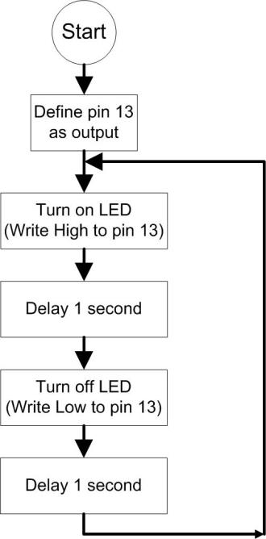
LED Blink – Program Analysis 3
void setup( ) {
pinMode(LED_BUILTIN, OUTPUT); // define operation // mode of LED pin
}
void loop( ) {
digitalWrite(LED_BUILTIN, HIGH); // turn the LED off
delay(1000); // wait for a second
digitalWrite(LED_BUILTIN, LOW); // turn the LED on
delay(1000); // wait for a second
}

Slide 39
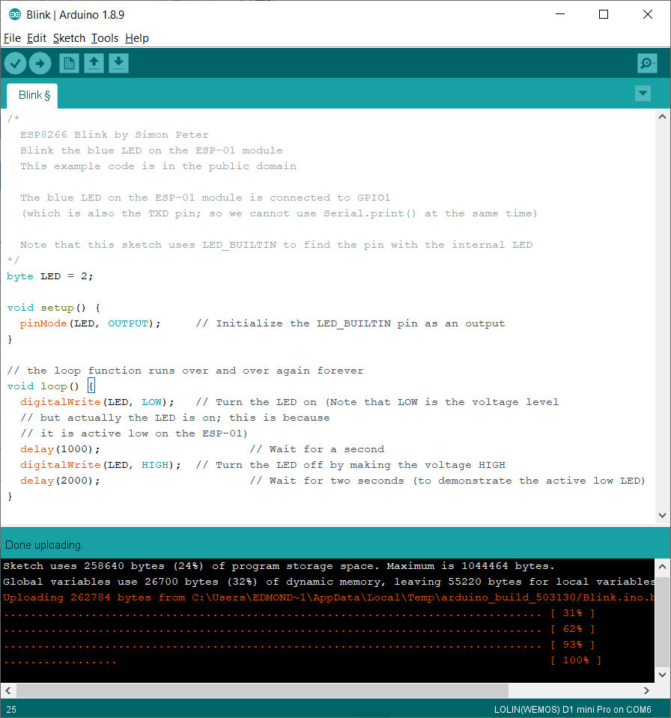
Using Variable to replace pin number
Declare a variable type as “byte” and name of the variable as “LED” and this variable is equal to 2
2
LED
“LED” is equal to 2

Slide 40
Operation of variable
❶
18
int abc = 18;
abc = 33;
abc
❷
33
abc

Slide 41
Operation of variable 2
int abc, def;
abc = 18;
def = abc + 10;
18
❶
❶
abc
❷
❷
18
abc
10
def

Slide 42



Different type of variable
2015
199.99
‘L’
char user = ‘L’;
int year = 2015;
float price = 199.99 ;
Type | Memory size | value
boolean | 8 bit (1 Byte) | 1 or 0
byte | 8 bit (1 Byte) | 0~255
char | 8 bit (1 Byte) | -128 ~ 127 (ASCII)
int | 16 bit (2 Byte) | -32768 ~ 32767
Long | 32 bit (4 Byte) | -2147483648 ~ 2147483647
float | 32 bit (4 Byte) | ±3.4028235 e+38
double | 32 bit (4 Byte) | ±3.4028235 e+38

Slide 43
PWM LED Luminosity control and analogWrite
By using the function – analogWrite
to Produce a PWM signal to dim the LED

Slide 44
Concept of PWM
Pulse Width Modulation (PWM)
Using Pulses with different duty cycle to output a analog signal
* ESP8266 I/O pin output is 3.3V

Slide 45
Concept of PWM
Parameter of PWM
Output voltage = Pulse Voltage x width / period

Slide 46
PWM LED Luminosity control
int LED = 2; //define LED pin (PWM output)
// the setup function runs once when start-up
void setup() {
// initialize digital pin 3 as an output.
pinMode( LED , OUTPUT);
}
void loop() {
analogWrite(LED, 1023);
delay(100); // wait for 100 ms
analogWrite(LED, 768);
delay(100); // wait for 100 ms
analogWrite(LED, 512);
delay(100); // wait for 100 ms
analogWrite(LED, 256);
delay(100); // wait for 100 ms
analogWrite(LED, 0);
delay(100); // wait for 100 ms
}
analogWrite– function call to set the target pin to output 3.3V to 0V
analogWrite(LED, val)
function input 1 : target pin no.
Function input 2 : PWM pulse width
( 0 - 1023 )
0 = 0%, 1023= 100%
Repeat coding
How to improve it ?

Slide 47
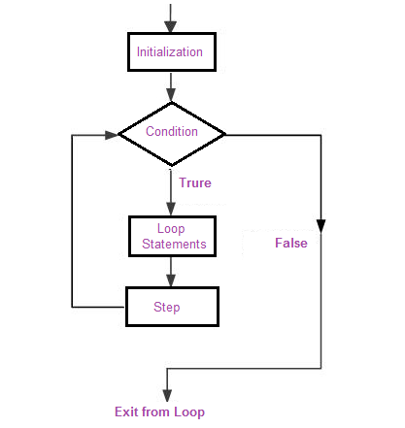
C – Syntax – For Loop
Initial value
Repeat condition
Increment method
int a = 0;
for (int i=0; i<=10; i++)
{
a = a + 1;
}
For Loop Syntax

Slide 48
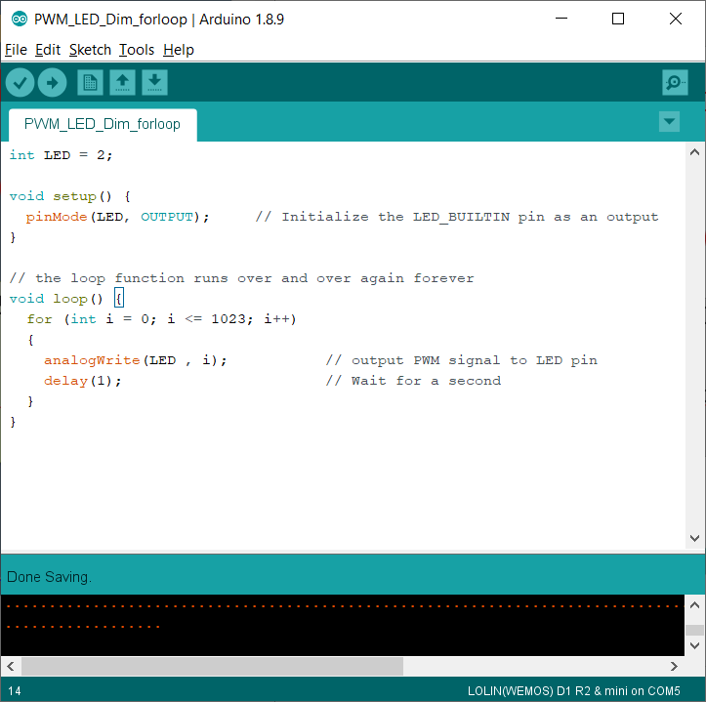
LED Dimming with for-loop
Initial value i = 2
Run the statement
when i less than or equal to 1023
for (i=0; i<=1023; i++)
{
analogWrite(LED, i);
delay(1);
}
Each time increase 1
Changing variable

Slide 49
6. Serial communication

Slide 50
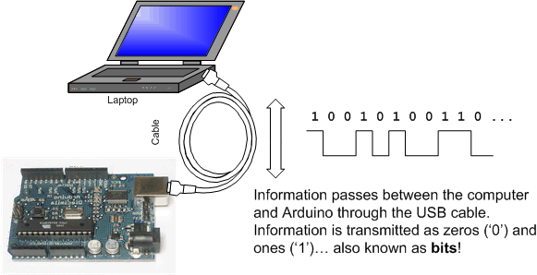
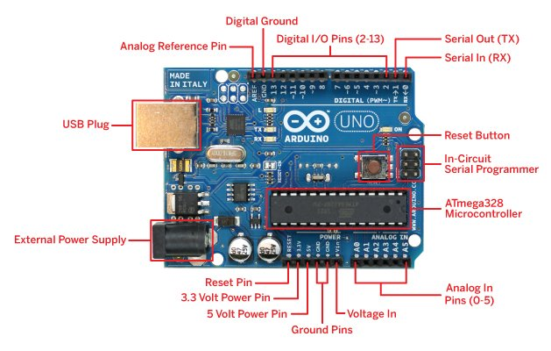
Concept of Serial communication

Slide 51
Serial connection of D1 mini board
USB

Slide 52
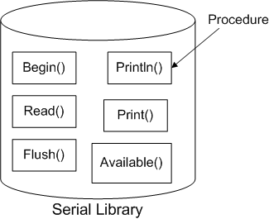
Serial Library

Slide 53
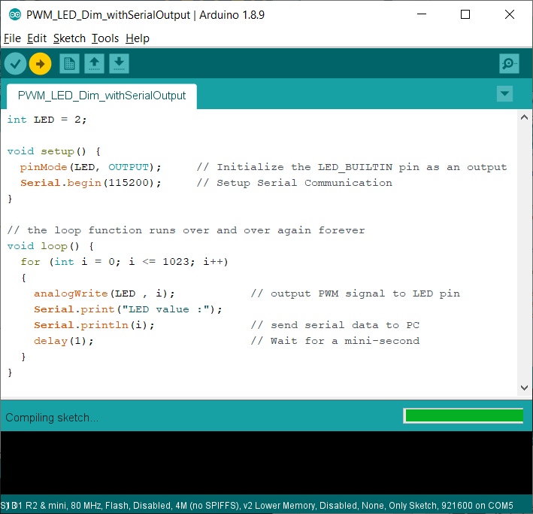
Serial Communication
Serial.begin– function call to setup a serial communication
Serial.begin(115200);
Serial.print(“LED value :");
Serial.println(i);
function input 1 : communication speed
Print words inside “ and “
Print value

Slide 54
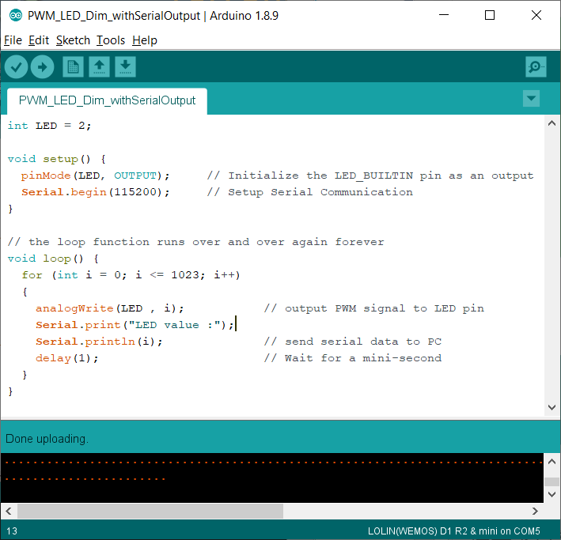
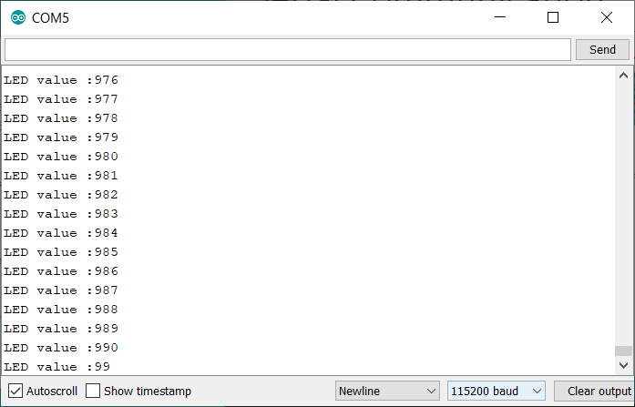
Serial Communication
To open serial monitor

Slide 55
Serial Communication
Send a char from PC to Ardunio to control LED Dimming
Serial.available() – function call to check any serial data received, return 1 when there is data received
Serial.available();
Serial.read() – function call to check the serial port is there any character, if yes output to val
val = Serial.read();

Slide 56
Serial read and “if… else…” syntax
if( a == b )
{
// True instruction
}
else
{
// False instruction
}
Condition
e.g. a == b, a < b , a > b , a!=b

Slide 57
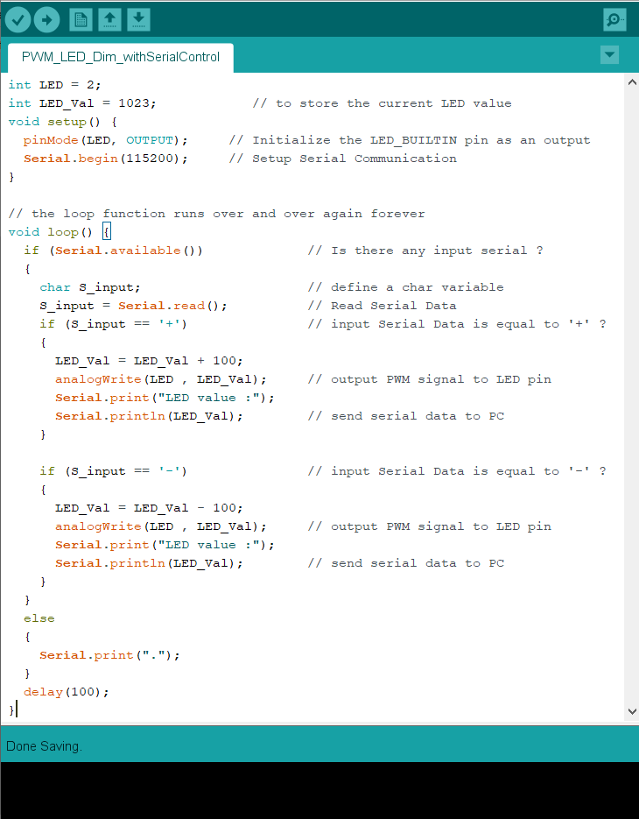
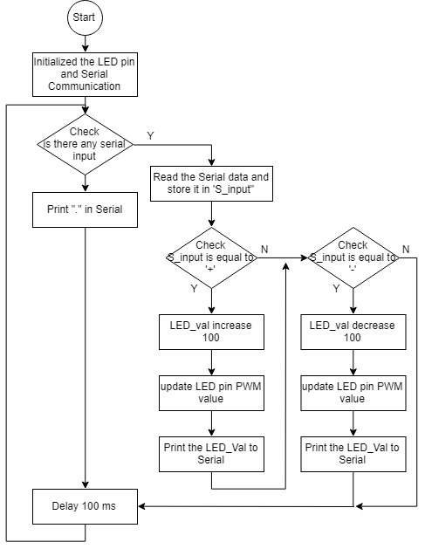

Slide 58
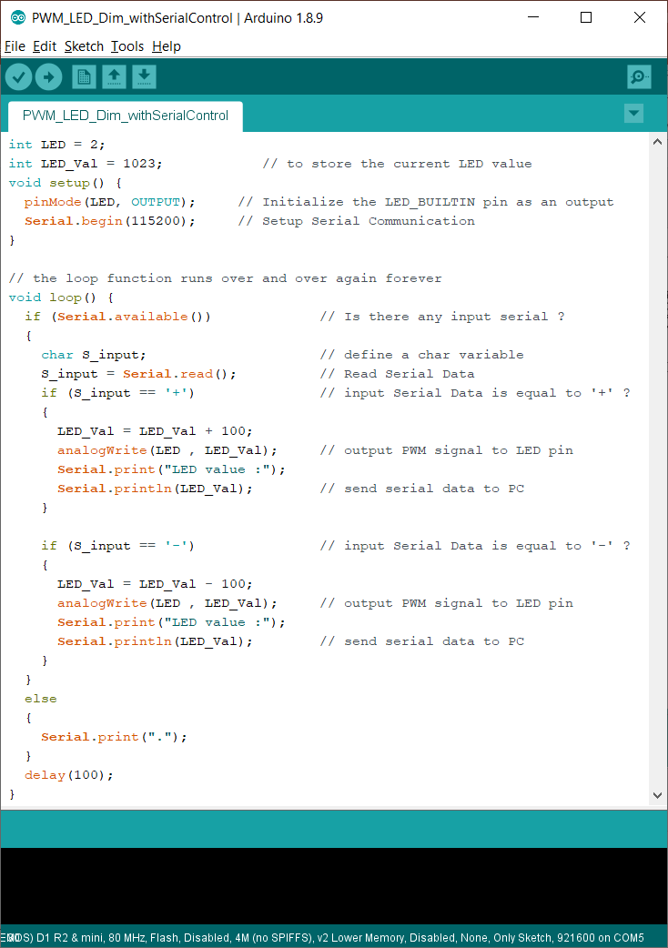
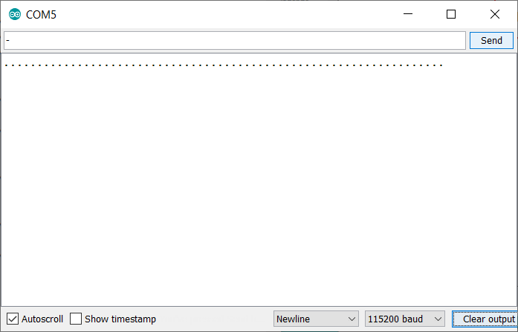
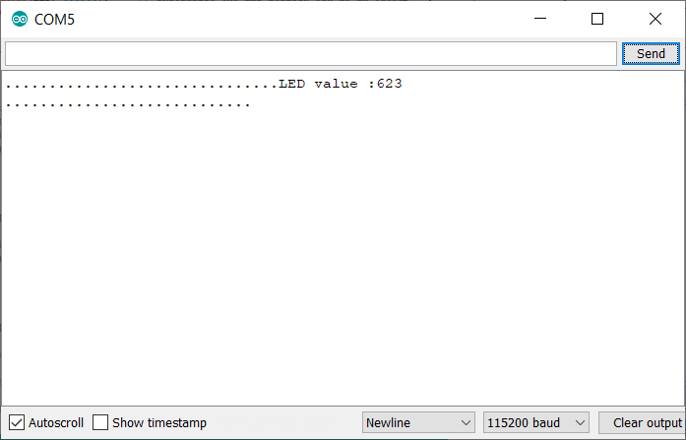
Input area

Slide 59
7.Motor control on ESP8266

Slide 60
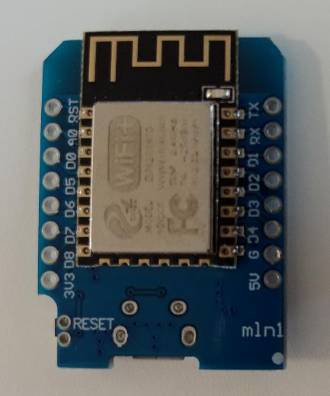
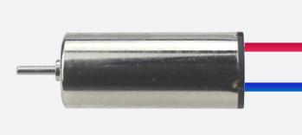
Motor Drive → H bridge circuit
I/O pin of the microcontroller cannot provide sufficient current to drive the motor and may damage the I/O pin

Slide 61


Motor Drive → H bridge circuit

Slide 62

What is a motor Drive ?
DC MOTOR | Mode | IN1 | IN2 | IN3 | IN4
MOTOR-A | Forward | 1/PWM | 0
 | Reversion | 0 | 1/PWM
 | Standby | 0 | 0
 | Brake | 1 | 1
MOTOR-B | Forward |  |  | 1/PWM | 0
 | Reversion |  |  | 0 | 1/PWM
 | Standby |  |  | 0 | 0
 | Brake |  |  | 1 | 1

Slide 63

Serial control – PWM Motor Driver
Objective:
Read PC-Serial data to output different PWM pulses to drive motors
Hardware pin on D1 mini | Arduino Pin no. | Connected to Motor Drive Pin | Controlling Motor
D1 | 5 | Drive 1 – IN1 | Motor #1
D2 | 4 | Drive 1 – IN2
D5 | 14 | Drive 2 – IN1 | Motor #2
D6 | 12 | Drive 2 – IN2
D7 | 13 | Drive 2 – IN3 | Motor #3
D8 | 15 | Drive 2 – IN4

Slide 64



Read Serial from buffer
Check the serial date is equal to + or -
Update the motor PWM

Slide 65
Serial control – PWM Motor Driver
Your turn :
Try to edit the program to control three motors

Slide 66
8.Android Wifi-hotspot and Wifi TCP/UDP Controller

Slide 67



Share Wifi on Android Phone
1
3
2

Slide 68



Share Wifi on Android Phone
6
5
4

Slide 69


Share Wifi on Android Phone
7
9
Edit your own SSD and Password and note it down !
8
10

Slide 70



Android Apps Setup
2
1
Download and install in Google Play
We will edit the IP later
3
8080
4
UDP
5

Slide 71


Android Apps Setup (Visibility)
6
7
Enable the following button
Button2, Button4, Button5, Button6
Button8, Button11 & Button 19
8

Slide 72

Android Apps Setup (Button Name)
Click on the button and edit their name
9
Button | Name
2 | Forward
4 | Left Turn
5 | Stop
6 | Right Turn
8 | Backward
11 | Up
19 | Down
10
11(After all 7 button is updated)

Slide 73

Android Apps Setup (Command)
Click on the button and edit their name
12
Button | Command
2 | f
4 | l
5 | s
6 | r
8 | b
11 | u
19 | d
13
14 (After all 7 button is updated)

Slide 74

Android Apps Setup (Display RX/TX)
16
17
18

Slide 75

Android Apps

Slide 76
9.Wifi (UDP package) between Android and ESP8266

Slide 77


Wifi(UDP) control – PWM Motor Driver
PWM
PWM
Serial
Objective:
Read UPD package from Wifi to control different PWM pulses to drive motors

Slide 78

UDP connection testing using Example program

Slide 79

UDP connection testing using Example program
Edit your own SSD and Password and note it down !
Update the SSID and Password same as your shared Wifi on Android
Change to 8080

Slide 80
UDP connection testing using Example program
Open Serial Monitor
Upload

Slide 81



UDP connection testing using Example program
The IP address of ESP8266 (D1 Mini)
The same IP also shown on your mobile phone

Slide 82

UDP connection testing using Example program
Edit the IP address

Slide 83

UDP connection testing using Example program
Button | Command
2 | f
4 | l
5 | s
6 | r
8 | b
11 | u
19 | d
When you click the Forward button, a ‘f’ command will send to ESP8266 through Wifi (UDP)

Slide 84

Example program analysis 1
Using the Library of ESP8266WiFi & WiFiUdp
Data for Wifi connection
Variable to store the UDP content
Serial Monitor Initialization
Initialization of Wi-Fi Connection
Print out the Wi-Fi Connection details to Serial Monitor

Slide 85

Example program analysis 2
Read the UDP packet and check anything received
Print out the Package details to Serial
We could insert program in here to control the motors by checking the content of “packetBuffet”
Print out the Package content and print to Serial
Return package

Slide 86
Try to control the motors through your mobile phone
Adding
Define the variable to store motors speed
The initialization of I/O pins for motors
Checking the content of UDP and updating the I/O PWMs

Slide 87

1. Define the variable to store motors speed

Slide 88

2. The initialization of I/O pins for motors

Slide 89

3. Checking the content of UDP and updating the I/O PWMs

Slide 90
Wifi(UDP) control – PWM Motor Driver
PWM
PWM
Serial
A reference program is provided

Slide 91


CAUTION
Don’t change the motor direction Rapidly. This action may burnt the motor driver. ( You may develop a program to avoid this happen)
The motor provided is a 3.7V motor. Max output should be less then 500 in Arduino.
Directly
PWM
CW
CCW
PWM
Serial
CW
STOP
CCW

Slide 92


Further development – close loop control
Height control
  Height sensor – MS5611
Direction control
  Inertial measurement unit - GY-LSM6DS3

Slide 93
Q & A

